Slide 1
Face mask detection
Presented by : FS19IF011
FS19IF026
FS19IF028
FS19IF029
Notes:
Presented by : FS19IF011
FS19IF026
FS19IF028
FS19IF029

Slide 2
INTRODUCTION
Face Mask Detection is an AI and Computer Vision driven image analytics solution which caters to the Covid-19 related violations. It’s artificial intelligence program detects violations like Face Mask Detection .This system can be deployed on the Hospitals , Office Premises , Government Offices , Schools and Education Institutes, Construction sites, Manufacturing units, Airports etc.
The camera with AI-based face mask detection and social distance monitoring can generate real-time alerts.
Face mask detection feature uses visible stream from the camera combined with AI techniques to detect and generate an alert for people not wearing face masks. A user-friendly interface allows monitoring and review of alerts generated by the system.
In the fight against the corona-virus to be a very effective measure to slow down the spread of the disease .

Slide 3
Objective :
To enforce the mandate for wearing masks in public places following the Covid-19 pandemic
To effectively provide a working model for accurate mask detection
To utilize Image processing approach to identify the presence of masks on face
To develop a efficient computer vision based system focused on real time automated monitoring of people to detect face mask in public places

Slide 4
Technologies used in this Project
Artificial Intelligence
Machine Learning
Deep Learning
OpenCV
Python
Software using: spyder 5.1 .1
Operating system: windows
Programming language: python

Slide 5
Required libraries
TensorFlow
Keras
OpenCV
NumPy
Imutils
Matplotlib

Slide 6
Computer vision
Computer vision is a process by which we can understand the images and videos how they are stored and how we can manipulate and retrieve data from them. Computer Vision is the base or mostly used for Artificial Intelligence. Computer-Vision is playing a major role in self-driving cars, robotics as well as in photo correction apps.

Slide 7
Deep learning model:
The model was trained with pictures of people with and without wearing face masks in public areas monitored with Closed-Circuit Television (CCTV) cameras.
Accuracy: The deep learning model achieved 98.7% accuracy.
Limitation: The model only detects masked faces and non-masked faces using Closed-Circuit Television (CCTV) cameras. None have been documented for real-time video streaming.

Slide 8
OpenCV library
OpenCV is the huge open-source library for the computer vision, machine learning, and image processing and now it plays a major role in real-time operation which is very important in today’s systems. By using it, one can process images and videos to identify objects, faces, or even handwriting of a human. When it integrated with various libraries, such as NumPy, python is capable of processing the OpenCV array structure for analysis. To Identify image pattern and its various features we use vector space and perform mathematical operations on these features.
OpenCV Functionality
Image/video I/O, processing, display (core, imgproc, highgui)
Object/feature detection (objdetect, features2d, nonfree)
Geometry-based monocular or stereo computer vision (calib3d, stitching, videostab)
Computational photography (photo, video, superres)
Machine learning & clustering

Slide 9
Tensorflow
TensorFlow is an open source software library for machine learning, developed by Google and currently used in many of their projects.
An easy, fast, and fun way to get started with TensorFlow is to build an image classifier: an offline and simplified alternative to Google’s Cloud Vision API where our Android device can detect and recognize objects from an image (or directly from the camera input).

Slide 10
Keras
Keras gives fundamental reflections and building units for creation and transportation of ML arrangements with high iteration velocity. It takes full advantage of the scalability and cross-platform capabilities of TensorFlow. The core data structures of Keras are layers and models [19]. All the layers used in the CNN model are implemented using Keras. Along with the conversion of the class vector to the binary class matrix in data processing, it helps to compile the overall model.

Slide 11
SYSTEM DESIGN MODELS:

Slide 12
Yolo-v2:
YOLO is one of the best models in object recognition, able to recognize objects and process frames at the rate up to 150 FPS for small networks. However, In terms of accuracy mAP, YOLO was not the state of the art model but has fairly good Mean average Precision (mAP) of 63% when trained on PASCAL VOC2007 and PASCAL VOC 2012. However, Fast R-CNN which was the state of the art at that time has an mAP of 71%.

Slide 13
RestNet50 model:
ResNet-50 is a convolutional neural network that is 50 layers deep. You can load a pretrained version of the network trained on more than a million images from the ImageNet database . The pretrained network can classify images into 1000 object categories, such as keyboard, mouse, pencil, and many animals.ResNet, short for Residual Networks is a classic neural network used as a backbone for many computer vision tasks. This model was the winner of ImageNet challenge in 2015. The fundamental breakthrough with ResNet was it allowed us to train extremely deep neural networks with 150+layers successfully.

Slide 14
MobileNet-v2:
MobileNet-v2 is a convolutional neural network that is 53 layers deep. You can load a pretrained version of the network trained on more than a million images from the ImageNet database .
The job of the MobileNet layers is to convert the pixels from the input image into features that describe the contents of the image, and pass these along to the other layers. Hence, MobileNet is used here as a feature extractor for a second neural network.

Slide 15
SPYDER SOFTWARE:
Spyder is an open-source cross-platform integrated development environment (IDE) for scientific programming in the Python language. Spyder integrates with a number of prominent packages in the scientific Python stack, including NumPy, SciPy, Matplotlib, pandas, IPython, SymPy and Cython, as well as other open-source software.

Slide 16
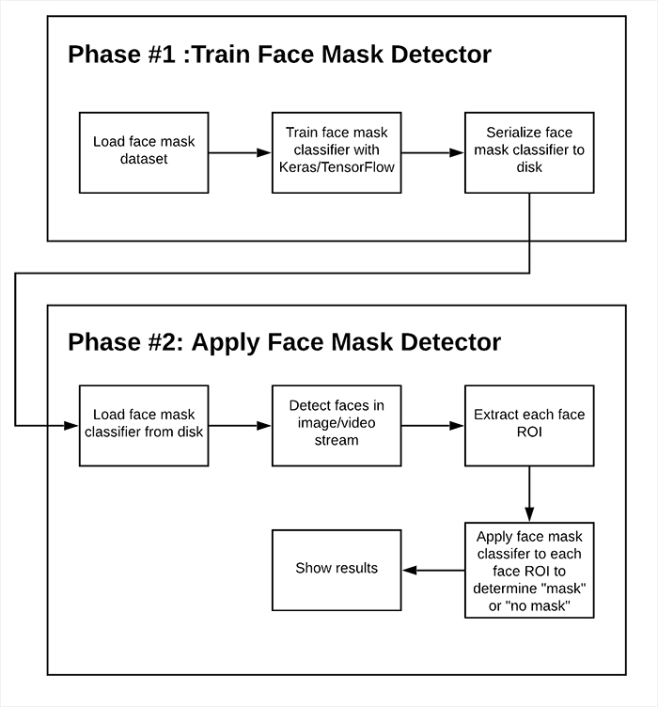
TWO PHASES : FACE MASK DETECTOR

Slide 17
TWO PHASES : FACE MASK DETECTOR
Training: Here we’ll focus on loading our face mask detection dataset from disk, training a model (using Keras/TensorFlow) on this dataset, and then serializing the face mask detector to disk
Deployment: Once the face mask detector is trained, we can then move on to loading the mask detector, performing face detection, and then classifying each face as
with_mask
Or
without_mask

Slide 18
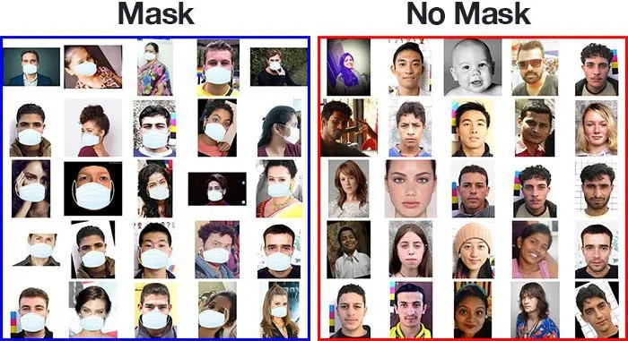
FACE MASK DETECTION DATASET

Slide 19
FACE MASK DETECTION DATASET
This dataset consists of 2000 images belonging to two classes:
with_mask : 1000 images
without_mask : 1000 images

Slide 20
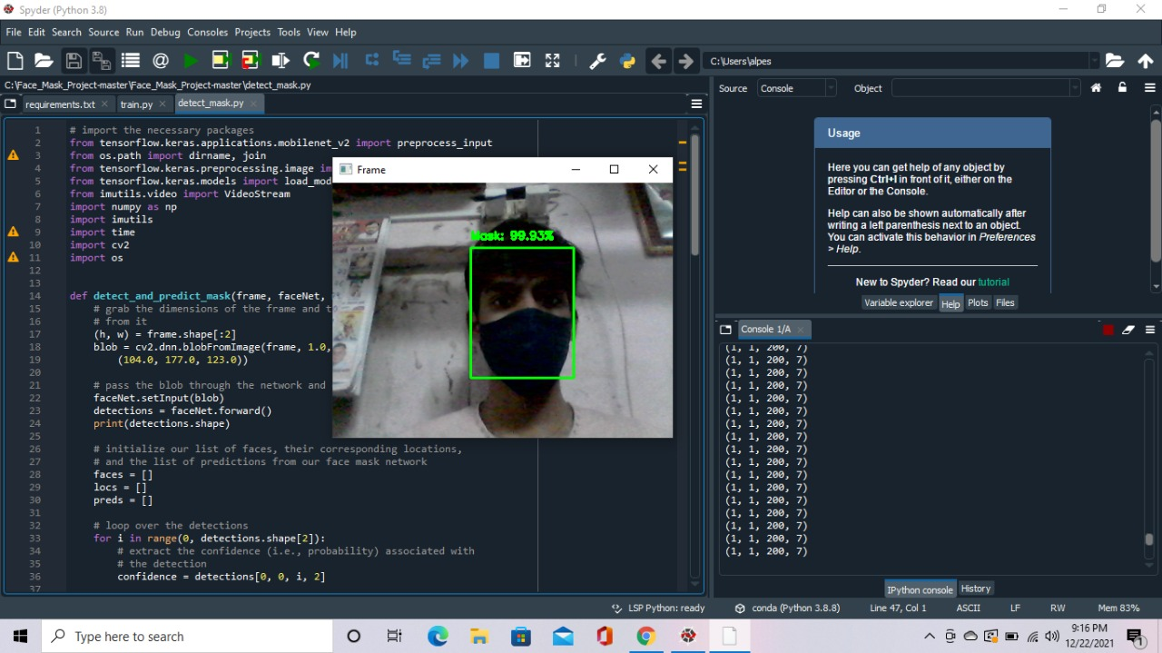
Outputs: With wearing mask:

Slide 21
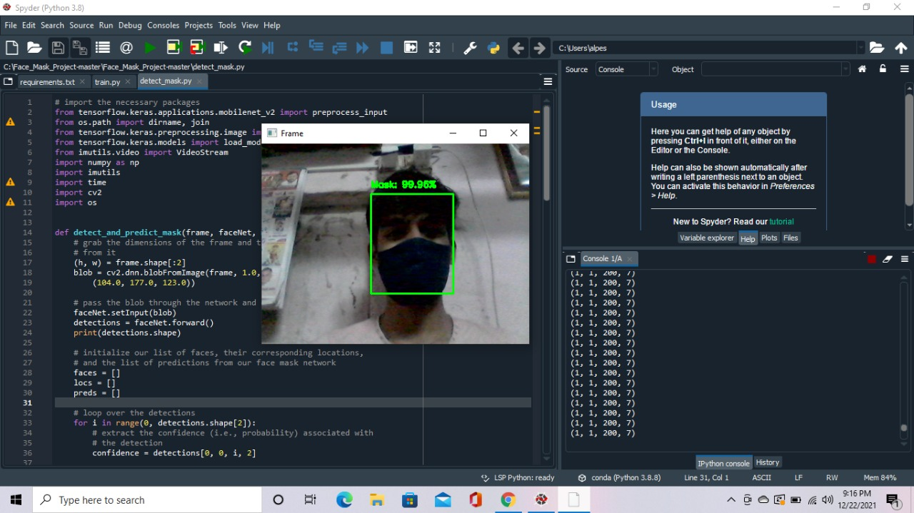

Slide 22
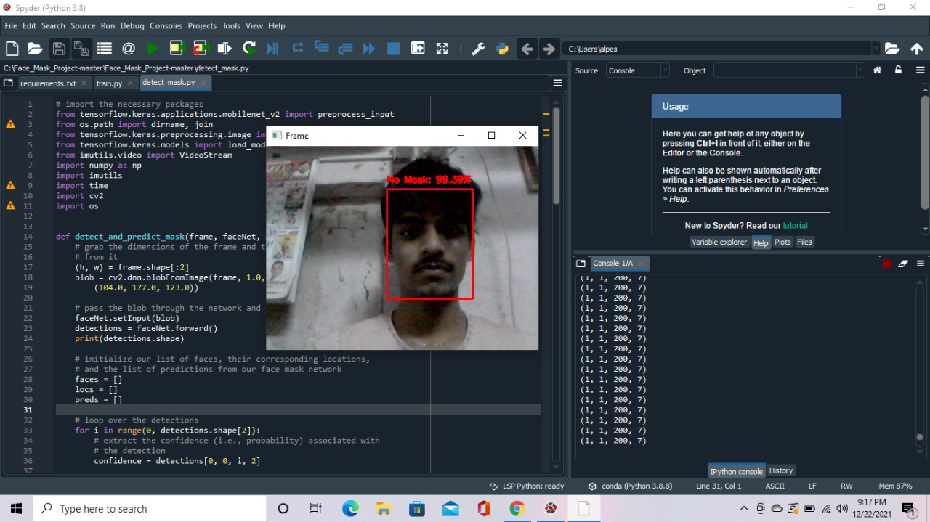
Without wearing mask:

Slide 23


Slide 24
Future scop:
As per available literature, very little body of research is attempted to detect mask over face. Thus, our work aims to a develop technique that can accurately detect mask over the face in public areas (such as airports. railway stations, crowded markets, bus stops, etc.) to curtail the spread of Coronavirus and thereby contributing to public healthcare.
We believe we can make this system more advanced in futures .Advances future and user interface will be updated in future.Our system is already user friendly by we will try to make this system more user friendly in future.

Slide 25
Conclusion :
Efficient image capturing
Efficient dataset training through CNN
Successful face mask detection
Maintaining alert status

Slide 26
Thanks
For
watching

